Slide 1
MECHATRONICS
EMG + Eye-Tracking
SMART MOBILITY SYSTEM
A hands-free control concept using muscle activity and eye gestures to command a small RC vehicle.
Prepared by: Akin

Slide 2
Project at a glance
Goal: demonstrate vehicle movement using one EMG sensor and eye gestures instead of a handheld joystick.
EMG input: muscle activation is read by an Arduino and sent to a laptop over USB serial.
Eye input: a webcam and Python-based eye tracking estimate eye-closure gestures.
Command link: the laptop sends movement commands over Wi-Fi to an ESP32 on the vehicle.
Actuation: an L298N dual H-bridge drives the two DC motors on the RC car.
02

Slide 3
Motivation and project aims
A proof-of-concept for accessible, hands-free control.
Challenge
Concept
Demonstration goal
A conventional mobility vehicle require physical strain to move and is extremely challenging for someone who is paralysed or has very minimal movement
Combine a muscle-activity signal for movement permission with eye gestures for directional steering.
Build a working, understandable end-to-end prototype and document its mechanical, electrical and software subsystems.
Project objectives
Read EMG sensor output and classify muscle activation.
Estimate eye gestures from webcam landmarks using Python.
Transmit commands to the ESP32 and control motor direction through the L298N.
Design and print custom brackets/mounts to organise and secure prototype hardware.
03

Slide 4
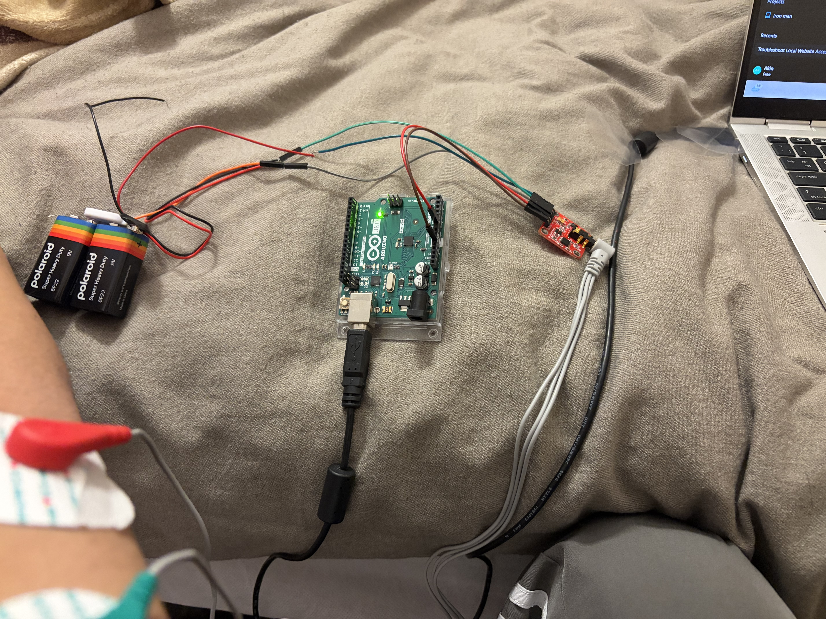
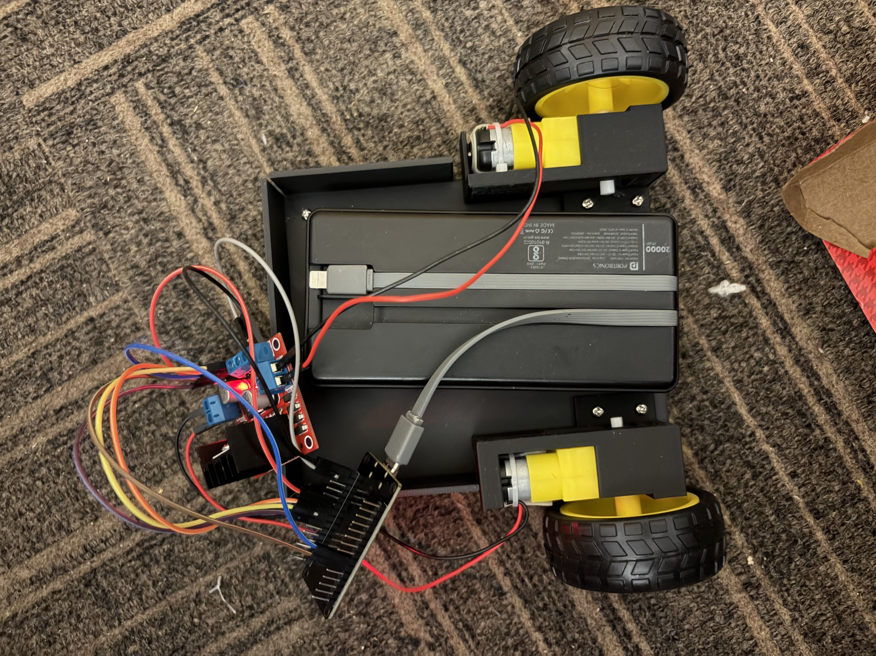
System architecture
Signal path from user input to vehicle movement.
EMG sensor
Arduino
Laptop / Python
Wi-Fi
ESP32 + L298N
Muscle signal
Read + classify
EMG + eye logic
HTTP command
Motor control
＋
EMG SENSOR + ARDUINO
Photo of sensor and wiring
＋
ESP32 + MOTOR DRIVER
Photo of electronics on vehicle
Note: the laptop is the integration point; it combines EMG serial data and eye-tracking output before sending a command.
04

Slide 5
Hardware and electronics
Main components and their roles.
EMG sensor module
Captures muscle-related electrical activity; output is read by Arduino analog input.
Arduino Uno / compatible board
Samples the EMG signal and sends readings or state over USB serial.
Laptop + webcam
Runs Python, processes eye landmarks and combines the input states.
ESP32
Hosts a small HTTP command endpoint over Wi-Fi.
L298N dual H-bridge
Controls polarity/direction for the two DC motor channels.
RC car chassis + DC motors
Provides the mobile platform for the proof-of-concept.
05

Slide 6
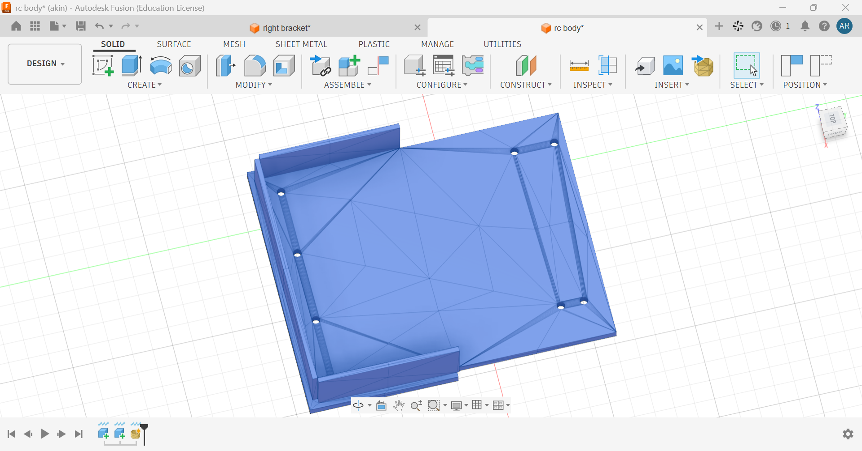
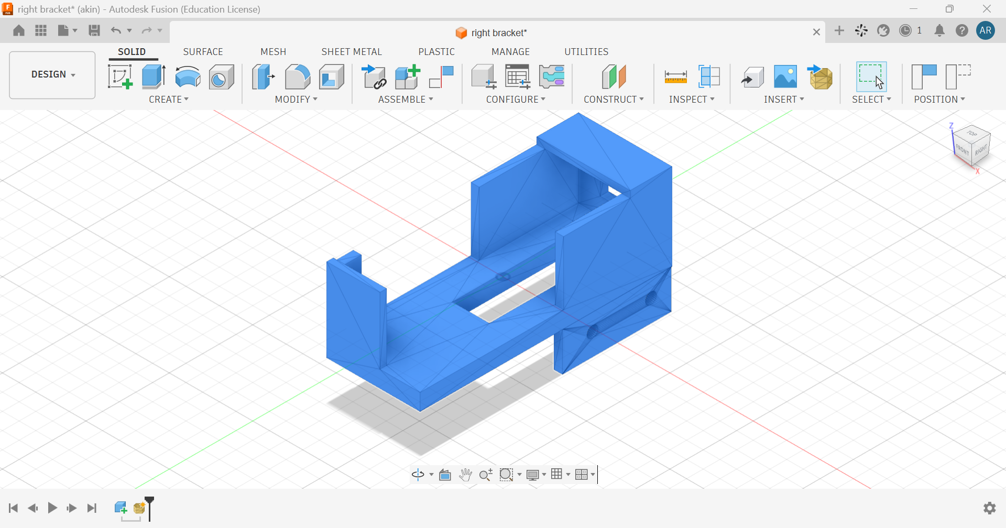
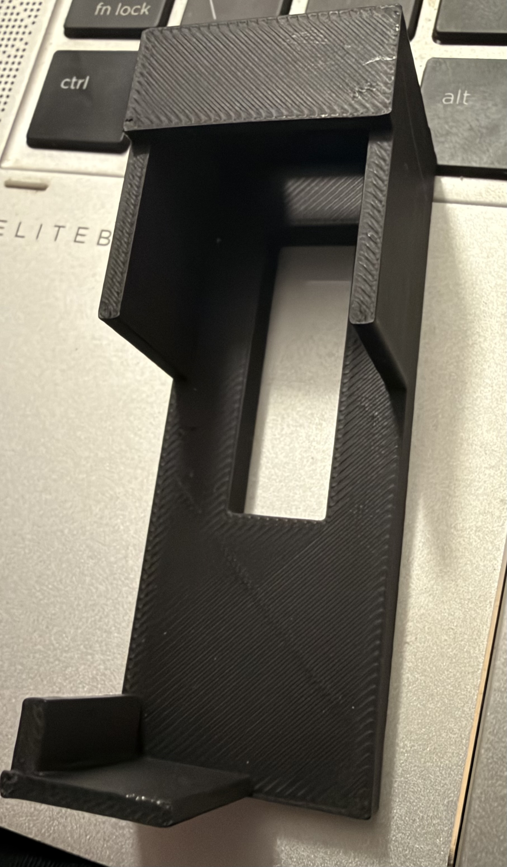
CAD design and 3D-printed brackets
Mechanical design supports integration, mounting and repeatable assembly.
CAD was used to plan and customise mounting geometry around the available prototype components.
3D-printed brackets can help secure electronics, route wires and reduce movement during testing.
＋
CAD MODEL
Insert Fusion 360 screenshot
＋
PRINTED BRACKET
Insert photo of printed part
＋
BRACKET ON CHASSIS
Insert mounted-part photo
＋
DETAIL / DIMENSIONS
Insert close-up or drawing
06

Slide 7
RC car and motor-driver integration
The ESP32 sends direction signals to the L298N.
ESP32 → L298N pin mapping
ENA → GPIO 25
ENB → GPIO 33
IN1 → GPIO 26
IN3 → GPIO 27
IN2 → GPIO 18
IN4 → GPIO 19
EMG + EYE-TRACKING CONTROLLED RC MOBILITY DEMONSTRATOR | PROJECT PROFILE
07

Slide 8
Software and communication
Three software layers work together.
1. Arduino EMG sketch
2. Laptop Python program
3. ESP32 web server
Reads analog input and compares it with activation/release thresholds. Sends readable serial output to the laptop.
Reads the Arduino serial stream, processes webcam eye landmarks and decides the requested movement.
Receives HTTP commands such as /cmd?move=FORWARD and sets L298N direction pins.
Typical development workflow
Upload the Arduino sketch and confirm stable serial readings first.
Start the ESP32 and confirm its Wi-Fi address is reachable from the laptop.
Run the Python integration script; verify each movement command with the wheels lifted clear of the floor.
Only then test the complete input-to-motion sequence at low speed in a clear area.
08

Slide 9
Control logic and command mapping
The intended logic uses EMG for movement permission and eyes for steering.
EMG state | Eye state | Requested command
Active | Both eyes open | FORWARD
Active | Right eye closed | LEFT
Active | Left eye closed | RIGHT
Inactive / invalid | Any state | STOP
Safety behaviour
If EMG data times out or input becomes invalid, the intended fallback is STOP.
Eye gestures
Blinking can happen naturally; use a short hold/debounce window to reduce accidental steering.
09

Slide 10
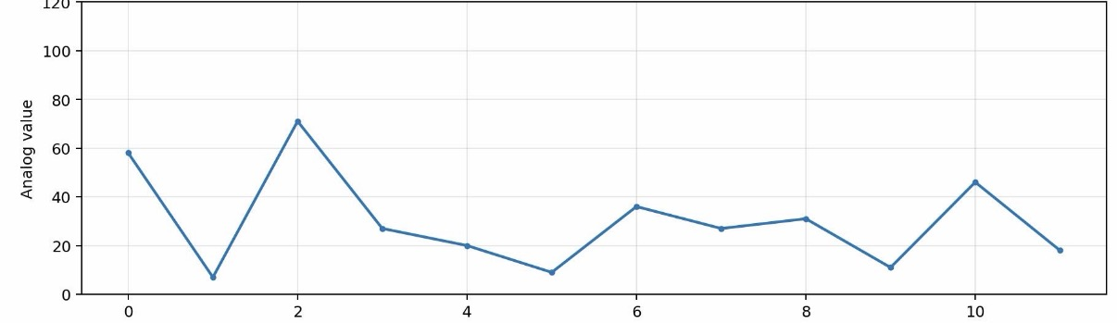
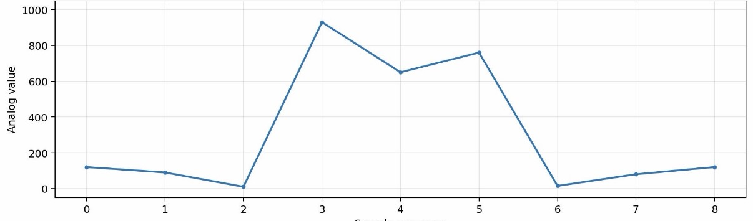
EMG GRAPH
Emg graph when relaxed
HTTP responses for STOP / FORWARD / LEFT / RIGHT were reported as successful.
Motor-driver pin tests have been used to check motor response; confirm both sides under final wiring.
Python eye-tracking output has previously produced LEFT / RIGHT classifications.
EMG graph when strained
Recent debugging included readings stuck at 1023 and an activation state remaining IDLE; analog input and thresholds need verification.
Final end-to-end reliability and repeatable demonstration still need to be validated.
11

Slide 11
Engineering challenges and lessons learned
Debug each subsystem independently before combining them.
EMG saturation / thresholding
Network reliability
Mechanical fit
THE EMG SENSOR BEHAVES BIT DIFFERENTLY SOMETIMES BECAUSE OF THE WORE OUT ELECTRODES AND HAD TO BUY FRESH NEW SETS IN BULK
MY PC WASN’T CONNECTING TO THE LOCAL SERVER, TURNED OUT TO BE A SIMPLE VPN AND FIREWALL ISSUE
I DIDN’T HAVE ANY ZIP TIE TO ATTACH MY MOTOR TO CHASIS SO I JUST 3D PRINTED A PERFECT BRACKET THAT CAN FIT IN PLACE WITHOUT ANY FASTENERS.
12

Slide 12
Next steps and improvements
Prioritised work to move from prototype to a convincing demonstration.
1. This prototype uses only one emg sensor and an additional emg sensor can be used to add reverse feature as well
2.Closing one eye to steer might be dangerous while implementing in real life so adding an imu sensor around head and using orientation difference to steer left or right
3. Using emg sensor with sticking electrode isn’t viable especially for daily use
Success criteria
The car responds predictably to intended inputs, stops safely when inputs are absent, and the build can be explained and reproduced.
13

Slide 13
CONCLUSION
A multi-subsystem mechatronics prototype
This project brings together sensing, signal interpretation, computer vision, wireless communication, motor control and custom mechanical design in one accessible mobility-control concept.
Thank you
14

